Slide 1
Year 12
Titration

Slide 2
Titration
Sorting out some confusing terms
When you carry out a simple acid-base titration, you use an indicator to tell you when you have the acid and alkali mixed in exactly the right proportions to "neutralise" each other. When the indicator changes colour, this is often described as the end point of the titration.
In an ideal world, the colour change would happen when you mix the two solutions together in exactly equation proportions. That particular mixture is known as the equivalence point.

Slide 3
Titration
For example, if you were titrating sodium hydroxide solution with hydrochloric acid, both with a concentration of 1 mol dm-3, 25 cm3 of sodium hydroxide solution would need exactly the same volume of the acid - because they react 1 : 1 according to the equation.
HCl + NaOH → NaCl + H₂O
In this particular instance, this would also be the neutral point of the titration, because sodium chloride solution has a pH of 7.

Slide 4
Titration
For example, if you titrate ammonia solution with hydrochloric acid, you would get ammonium chloride formed. The ammonium ion is slightly acidic, and so pure ammonium chloride has a slightly acidic pH.
That means that at the equivalence point (where you had mixed the solutions in the correct proportions according to the equation), the solution wouldn't actually be neutral. To use the term "neutral point" in this context would be misleading.

Slide 5
Titration
To summarise:
The term "neutral point" is best avoided.
The term "equivalence point" means that the solutions have been mixed in exactly the right proportions according to the equation.
The term "end point" is where the indicator changes colour. It is not necessarily exactly the same as the equivalence point.

Slide 6
Titration
Titration curves for strong acid v strong base
We'll take hydrochloric acid and sodium hydroxide as typical of a strong acid and a strong base.
HCl + NaOH → NaCl + H₂O

Slide 7
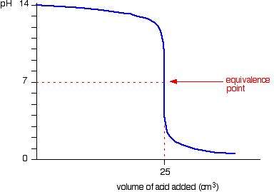
Titration
Running acid into the alkali

Slide 8
Titration
You can see that the pH only falls a very small amount until quite near the equivalence point. Then there is a really steep plunge. If you calculate the values, the pH falls all the way from 11.3 when you have added 24.9 cm3 to 2.7 when you have added 25.1 cm3.

Slide 9
Titration
Running alkali into the acid
This is very similar to the previous curve except, of course, that the pH starts off low and increases as you add more sodium hydroxide solution.

Slide 10
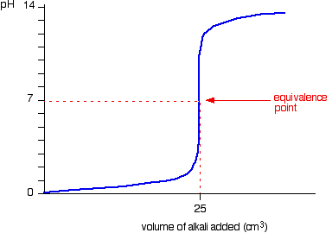
Titration
Again, the pH doesn't change very much until you get close to the equivalence point. Then it surges upwards very steeply.

Slide 11
Titration
Titration curves for strong acid v weak base
This time we are going to use hydrochloric acid as the strong acid and ammonia solution as the weak base.
NH₃ + HCl → NH₄Cl

Slide 12
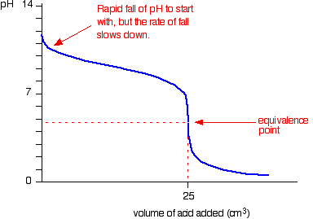
Titration
Running acid into the alkali

Slide 13
Titration
Because you have got a weak base, the beginning of the curve is obviously going to be different. However, once you have got an excess of acid, the curve is essentially the same as before.
At the very beginning of the curve, the pH starts by falling quite quickly as the acid is added, but the curve very soon gets less steep. This is because a buffer solution is being set up - composed of the excess ammonia and the ammonium chloride being formed.

Slide 14
Titration
Notice that the equivalence point is now somewhat acidic ( a bit less than pH 5), because pure ammonium chloride isn't neutral. However, the equivalence point still falls on the steepest bit of the curve. That will turn out to be important in choosing a suitable indicator for the titration.

Slide 15
Titration
Running alkali into the acid
At the beginning of this titration, you have an excess of hydrochloric acid. The shape of the curve will be the same as when you had an excess of acid at the start of a titration running sodium hydroxide solution into the acid.
It is only after the equivalence point that things become different.
A buffer solution is formed containing excess ammonia and ammonium chloride. This resists any large increase in pH - not that you would expect a very large increase anyway, because ammonia is only a weak base.

Slide 16
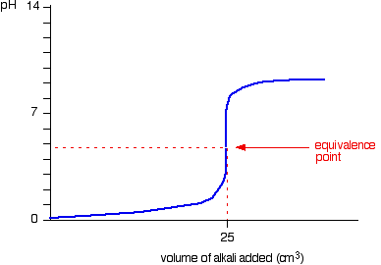
Titration
A buffer solution is formed containing excess ammonia and ammonium chloride. This resists any large increase in pH - not that you would expect a very large increase anyway, because ammonia is only a weak base.

Slide 17
Titration
Titration curves for weak acid v strong base
We'll take ethanoic acid and sodium hydroxide as typical of a weak acid and a strong base.
CH₃COOH + NaOH → CH₃COONa + H₂O

Slide 18
Titration
Running acid into the alkali
For the first part of the graph, you have an excess of sodium hydroxide. The curve will be exactly the same as when you add hydrochloric acid to sodium hydroxide. Once the acid is in excess, there will be a difference.

Slide 19
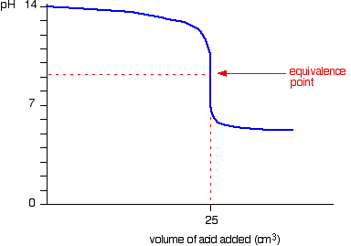
Titration
Past the equivalence point you have a buffer solution containing sodium ethanoate and ethanoic acid. This resists any large fall in pH.

Slide 20
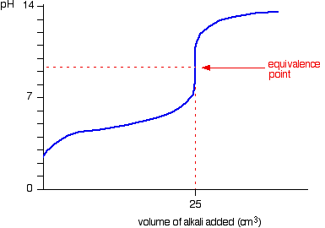
Titration
Running alkali into the acid
The start of the graph shows a relatively rapid rise in pH but this slows down as a buffer solution containing ethanoic acid and sodium ethanoate is produced. Beyond the equivalence point (when the sodium hydroxide is in excess) the curve is just the same as that end of the HCl - NaOH graph.

Slide 21
Titration

